Slide 1

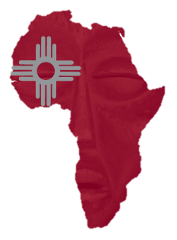
A Conversation with Sybrina Fulton, mother of Trayvon Martin
Africana Studies
Black History Month Kick-Off Brunch
Stand Your Ground as a Civil Rights Issue
Saturday, January 25, 2014
11 a.m.
SUB Ballrooms A, B, & C
Tickets: $30
Tickets on sale January 2, 2014 at www.unmtickets.com or the UNM Ticket Office
For table sales, please contact Prof. Mathewson at mathewson@law.unm.edu
For additional details, visit http://africanastudies.unm.edu or call 505.277.5644
UNM | Africana Studies
Home of African American & African Diaspora Studies
at UNM

